Slide 1
Program Director Orientation
Elizabeth Strong, Director
Yingying Li, Accounting Specialist
Morgan Marler, Administrative Assistant

Slide 2
Agenda
Health & Behavior
Title IX
Emergency Plan
Legal Counsel
Program Conclusion
Online Application Materials
Program Director requirements
Financial Matters

Slide 3
Student Health & Behavior

Slide 4
GeoBlue Health Insurance
#globalbears
Register
Enroll
Download
Check your MSU email address for insurance card
Download the GeoBlue app and log in.
Students may give their certificate number to parents for enrollment on GeoBlue’s parent site
Students: www.geobluestudents.com

Slide 5
GeoBlue Insurance: Using your coverage
Receiving services:
Coverage Overview:
In order to avoid paying any fees, contact GeoBlue before your appointment so that GeoBlue can guarantee payment to the provider. Filing a claim is only necessary when a guarantee of payment has not been made in advance. Submitting a claim is easy, you can find the form on the GeoBlue app.
Deductible
Maximum Benefit per Injury
Medical Evacuation
$0 per Injury/Sickness
$250,000
$250,000 Maximum
Bedside Visit
$3,000 Maximum

Slide 6
Health Insurance
The GeoBlue phone number for program directors and students while outside the U.S. is 1-610-254-8771 (for medical assistance while abroad, i.e., finding a provider, accessing care) or 1-610-263-2847 (benefit and claim questions). All collect calls are accepted. The email is globalhealth@geo-blue.com.
You may submit a claim for reimbursement if you have received medical services from personnel outside the GeoBlue network.
Please review the documents in your orientation folder regarding:
Downloading the GeoBlue app
GeoBlue direct pay
Receiving GeoBlue services

Slide 7
GeoBlue and COVID
GeoBlue does cover...
GeoBlue does not cover...
Non medically necessary transportation costs due to COVID-19
Lodging and meal expenses for quarantining, (e.g., in a hotel room or a medical facility)
COVID-19 test as a requirement for travel (e.g., before flying)
COVID just as other illnesses are covered
Medically prescribed testing
Medically necessary treatment
Medically appropriate evacuation and repatriation

Slide 8
In the event of a positive COVID test...
If you must stay in the host country to wait for one or more of your students to be cleared for travel, Education Abroad will cover your lodging, meals, and transportation based on MSU’s travel reimbursement policy.
Education Abroad will not cover tourist attractions or other items.
If you test positive for COVID and must be quarantined, Education Abroad will cover your quarantine expenses.

Slide 9
Student Leader responsibilities
If program director must stay behind with a student or the program director is unable to accompany group back to the States
If the program director becomes incapacitated or dies

Slide 10
Unum – replaced Cigna as of 2022
USE YOUR TRAVEL ASSISTANCE PHONE NUMBER TO ACCESS:
Hospital admission assistance*
Emergency medical evacuation
Prescription replacement assistance
Transportation for a friend or family member to join a hospitalized patient
Care and transport of unattended minor children
Assistance with the return of a vehicle
Emergency message services
Critical care monitoring
Emergency trauma counseling
Referrals to Western-trained, English-speaking medical providers
Legal and interpreter referrals
Passport replacement assistance
Available to full time benefits eligible employees of Missouri State University.

Slide 11
Health Form
Overall Health
Allergies & Dietary Needs
Medication
Mobility/Physical Restrictions
Disability
Hearing or Visual Loss
Physical & Mental Health
Education Abroad is committed to providing excellent programs for our students, while providing a safe and accommodating environment.
Applicants are required to self-disclose their health history to assist Education Programs and Faculty Directors with accommodating their needs. Please make sure to review these forms prior to admission and departure of the program.

Slide 12
World Wide Travel Caution
Exercise vigilance when in public places or using transportation.
Be aware of immediate surroundings and avoid large crowds or crowded places.
Follow the instructions of local authorities. Monitor media and local information sources and factor updated information into personal travel plans and activities.
Be prepared for additional security screening and unexpected disruptions.
Stay in touch with Education Abroad in the event of an emergency. Encourage students to contact family members to verify safety.
Education Abroad will register you and your program participants in the Smart Traveler Enrollment Program (STEP).
What does that mean?

Slide 13
STEP Registration is complete for your program
1-2 Months Prior to Departure
1-2 Weeks Prior to Departure
Program Departure
Education Abroad will request specific lodging details for your program
All U.S. citizen participants will be enrolled in STEP by Education Abroad
Embassy is aware of your program’s travel itinerary in case of crisis

Slide 14
Communication

Slide 15
Behavioral Contract
Cultural Differences
Unacceptable Behavior
Timeliness
Respect for Others
Positivity
Acceptable Behavior
Tardiness
Rudeness
Negativity
Program Directors are required to discuss behaviors expected [or not expected] on the program with participants.
Education Abroad provided a behavioral contract for your use.

Slide 16
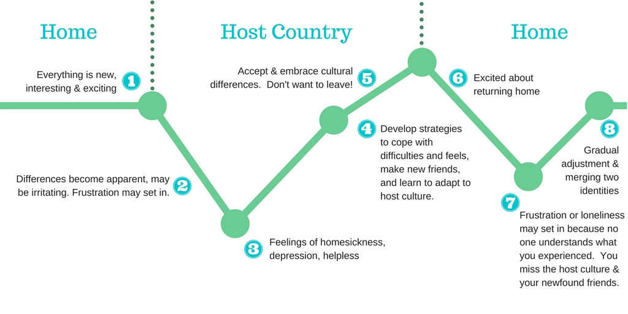
Culture Shock: What to Expect
#globalbears

Slide 17
Title IX
#globalbears
Missouri State University has a Title IX policy that guides our responses to sexual violence. The Title IX policy is located on the MSU Title IX website at www.missouristate.edu/titleix/.
The MSU Title IX Office is available to students whether they are on the MSU campus or away. Students may reach the office by phone or email when they are away from campus. The information students share with Title IX is confidential. Title IX staff will offer support and resources, answer questions, and provide options for how to proceed.
Melissa Berry, Interim Title IX Coordinator 836-4252 Carrington 205

Slide 18
Title XI applies to:
Sexual Assault
Domestic and Dating Violence
Stalking
Sexual Harassment

Slide 19
Responsible Employees
Responsible Employees are people who are required to notify the Title IX Office if they become aware of a possible Title IX violation.
Responsible Employees are:
Instructors and Professors
Program Directors
Director, Education Abroad

Slide 20
For assistance, students may contact:
Title IX Office
You, the Program Director
417-836-6368
MBerry@MissouriState.edu; AshleyReece@MissouriState.edu
Melissa Berry or Ashley Reece
Elizabeth Strong
ElizabethStrong@MissouriState.edu
Education Abroad
(417) 836-4252; 417-836-8510

Slide 21
Emergency Response Plan
The Emergency Response Plan has been established to maintain communication with appropriate personnel to prevent life threatening situations while providing a climate of safety and maintaining confidentiality of the affected individual(s).

Slide 22
Understanding the Emergency Response Plan
Program Director Actions:
Identify Emergency
Communicate all information to Elizabeth Strong
The Emergency Response Team uses emergency response procedures to help administrators who will:
Gather information;
Establish communication with the family;
Disseminate accurate information to faculty, students, and media;
Intervene directly with students most likely to be affected; and
Increase the available support for students and staff.
Real Emergency
Perceived Emergency
Critical Incident
A genuine or imminent threat to students or faculty (i.e. serious health issue, emotional stability, victim of crime, or national crisis)
No immediate risk, but rather, cause for concern that requires monitoring for preventative measures
Situations involving threats of harm to students, faculty, or facilities. In addition, academic or conduct violation, disruption of group, and potentially dangerous situations are considered critical incidences.

Slide 23
Emergency Response Team
Elizabeth Strong
Brad Bodenhausen
Jim Baker
Frank Einhellig
Ryan DeBoef
Rachael Dockery
Suzanne Shaw
Dee Siscoe
David Hall

Slide 24
Death of a Student
The death of a student is the ultimate tragedy. It is a rare instance, and MSU relies heavily on guidance from the Core Executive Team and the U.S. Embassy.
Do not immediately reach out to family members and emergency contacts. WAIT FOR DIRECTION. Do not speak to the press. All request must go through University Communications. Do not post information on social media. Instruct students not to post. Do gather information regarding circumstances as best you can – inquire but do not investigate.
Contact Elizabeth Strong at (417) 225-8430 (cell).
Contact the U.S. Embassy, per your approved Emergency Response Plan.

Slide 25
Death of a Student
Document the following:
Time, location and manner of death
Current location of the remains
Whether an autopsy is required
Keep an event log of events in country
Meet with program participants (as a group or individually) to ensure their safety and care.
Request that other program participants not discuss the incident on social medial until family can be notified. This is important because social media posts may be inaccurate, and may cause undue stress for family members. Additionally, this news should be received from the U.S. Embassy or the Dean of Students, with experience in emotionally supporting family members as difficult news is communicated.
Determine if on-site counseling is available for other program participants.
Gather belongings of deceased participant for repatriation.
Be available 24/7 to MSU and the participants; expect the follow up from this incident to be all-consuming for at least several days after the incident
Complete the Incident Report Form.

Slide 26
Incident Report Form
What to Report
Student Injury
Major or Minor
Broken Leg, Arm, etc.
Sexual Harassment or Assault
Student Hospitalization
How to Report
Incident Report Form
Activate Emergency Response Plan if serious incident

Slide 27
Clery Act
The Jeanne Clery Disclosure of Campus Security Policy and Campus Crime Statistics Act requires U.S. colleges and universities to disclose information about crime on and around their campuses, or in off-campus facilities as described in the Act.
The Education Abroad Final Report will include your verification of where you stayed on your program as Clery is concerned with where crimes occurred. Education Abroad contacts the local policy for crime statistics for those areas. Education Abroad reports those statistics to University Safety for MSU’s Clery report.

Slide 28
Clery crime categories
Murder/Non-negligent Manslaughter
Negligent Manslaughter
Forcible Sex offenses
Non-forcible Sex offenses
Robbery
Burglary
Aggravated Assault
Motor Vehicle Theft
Arson
Domestic Violence
Dating Violence
Stalking

Slide 29
Legal Counsel points
Always err on the side of communicating/reporting, e.g., Title IX, Clery, injury, students of concern.
You are acting in the course and scope of your employment while on an Education Abroad Program. This means you have the same expectations and protections as you do while on campus, e.g., you are insured by the State Legal Expense Fund. Conversely, students are not covered by the State Legal Expense Fund.

Slide 30
Online Application

Slide 31
Finalizing Student Requirements
Ensure all participants statuses are listed as “Ready for Departure”
Review “Emergency Contact List”
Complete final review of “Health Forms”

Slide 32
Education Abroad Online Application
Each student’s application status must be “Ready for Departure.”
If the application states “Participation Confirmed,” the student needs to click the submit button to change the status.
* If the student cannot click the submit button, it is because the student has not completed at least one post-acceptance item. Each student must complete all application items, and then click the submit button.

Slide 33
Course registration
Students who have no registered yet
Sarah Sommer
Remy Bilodeau
Michael Paul
Logan Rogers
4/18 : GLG 413 sent out to all MSU students.
4/22 : All external students were registered by the Registrar's office.

Slide 34
Education Abroad Courses
Registrar’s Office requires that you submit an I (incomplete) for each student on your program.
May education abroad programs are classified as spring semester classes.
When students have completed the course work, change their grades to the appropriate letter grade.
Any participants who graduate in May, June 30, 2022 at 5 pm. For several seniors, the May education abroad course will apply towards their graduation requirements.

Slide 35
Financial Matters
SET card
Before you leave
Cash Advances may be obtained through using the SET card and a PIN# at a UMB ATM
SET Card withdrawals are not charged a Foreign Transaction Fee or a Cash Withdrawal fee if used at a UMB ATM and can be used in Foreign ATM’s
All programs traveling internationally must have a Travel Authorization on file 30 days in advance
Pick up your Financial Tracking Folder from Yingying Li.
Review Financial Services policies on acceptable expenses for any Travel Expenses.
Track purchases and available balances on your SET Card by logging into: https://www.commercialcardcenter.com

Slide 36
Student Payments
Program Fees
Refunds
Students must pay their entire program fee according to the established deadlines:
Education Abroad works diligently to reconcile program accounts and issue any refunds to students.
Education Abroad will notify students if they are due a refund and asks that faculty do not promote refunds until the account has been reconciled.
Program Departs: | Payment Due:
March | January 31st
May | February 28th
June-August | April 30th
December-January | November 30th

Slide 37
After Program Returns
7 days after program concludes
Submit excess remaining cash (withdrawn from SET card) to the Bursar’s office. Provide your program budget number (FOAP) to Bursar when returning cash.
Return SET card to Isaac Balasundaram.
14 days after program concludes
Submit SET Card Log and Non-SET Card Travel Expense Report with supporting documentation of expenses to Yingying Li. Instructions will be provided later.
14 days after conclusion of your program
Education Abroad Report must be submitted via email to Elizabeth Strong.

Slide 38
Faculty Payments
Calculating Payment
Salary Payment
Faculty Directors can calculate their salary based on the spreadsheet available on Education Abroad’s website. https://international.missouristate.edu/educationabroad/compensation-formula-and-policy.htm
Your salary is based upon the students enrolled in your program course(s)
Your salary payment will be processed after your travel expenses and final report are submitted

Slide 39
Reflection Journals
If you ordered Education Abroad Reflection Journals, our staff will deliver them to your office approximately 1 week prior to your program's departure.

Slide 40
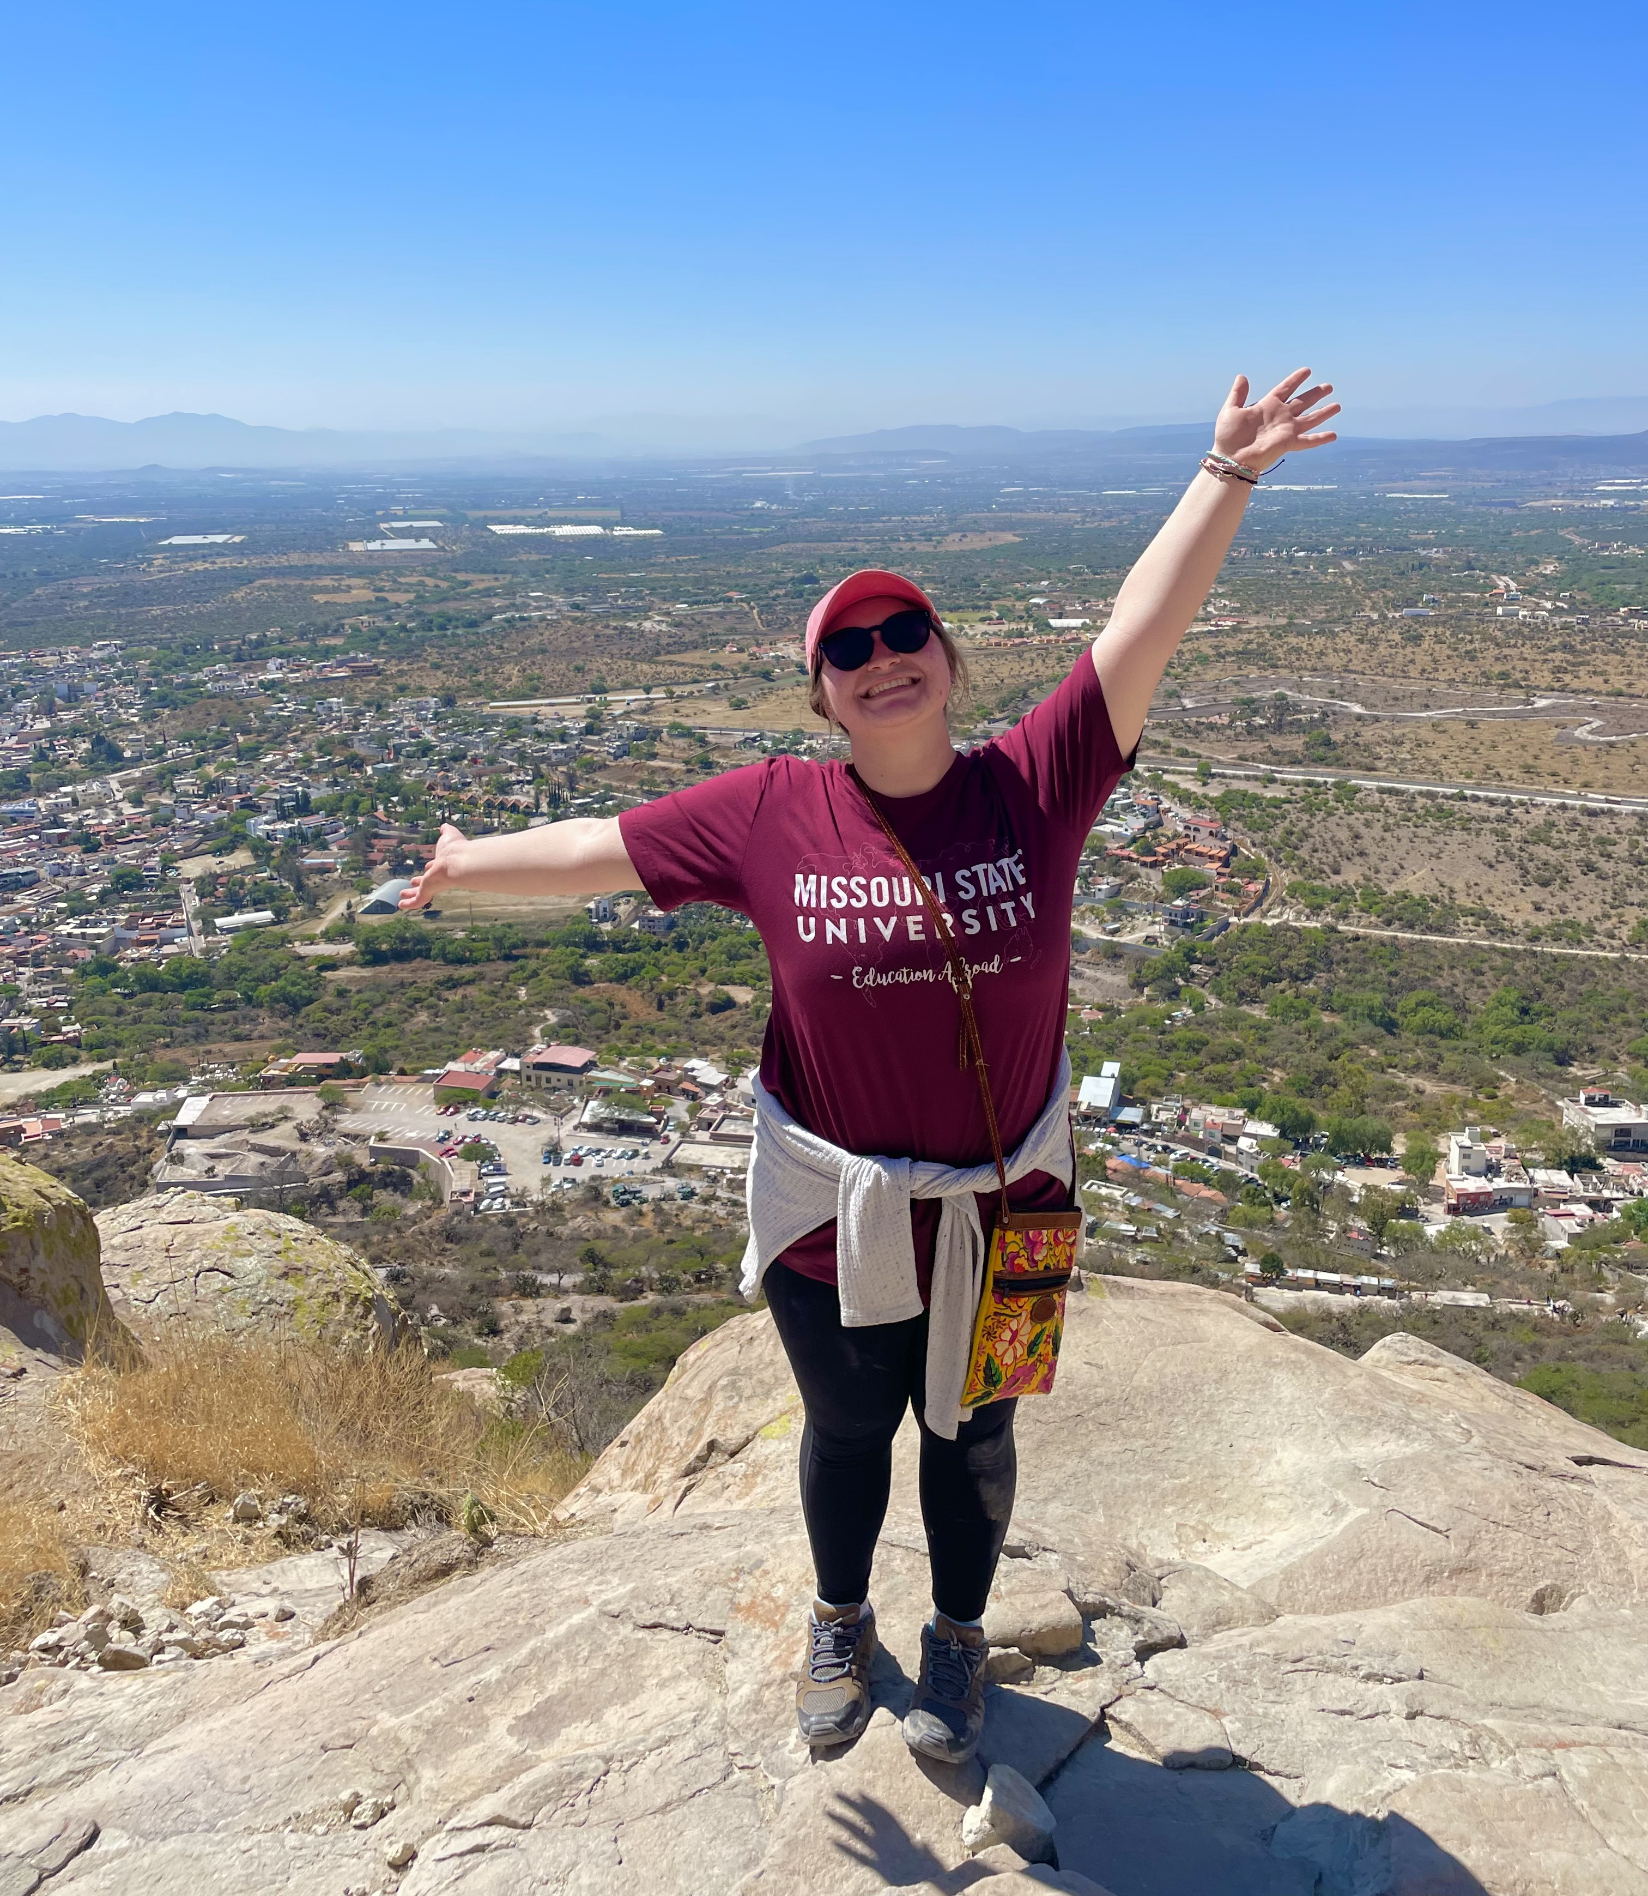
T-shirts
All travelers will receive an Education Abroad t-shirt before departure.
May programs – early May
Other programs- Approx. 3 weeks before your departure

Slide 41
Exciting News!
All short-term programs will be eligible for the 2023 photo contest!
Encourage your students to take awesome photos for the following categories!
Culture
Landmark
Bearwear
Basic rules:
Must include you or someone else (with their permission in the photos)
Awesome 1st, 2nd and 3rd place prizes in each category!
Students will receive an email about the contest deadline.

